Slide 1
Now that We’ve Finished Death of a Salesman, It Is Project Time:
Consider the emotions/feelings and attitudes that each painting evokes.
What does each say about American life in the mid 20th century?

Slide 2
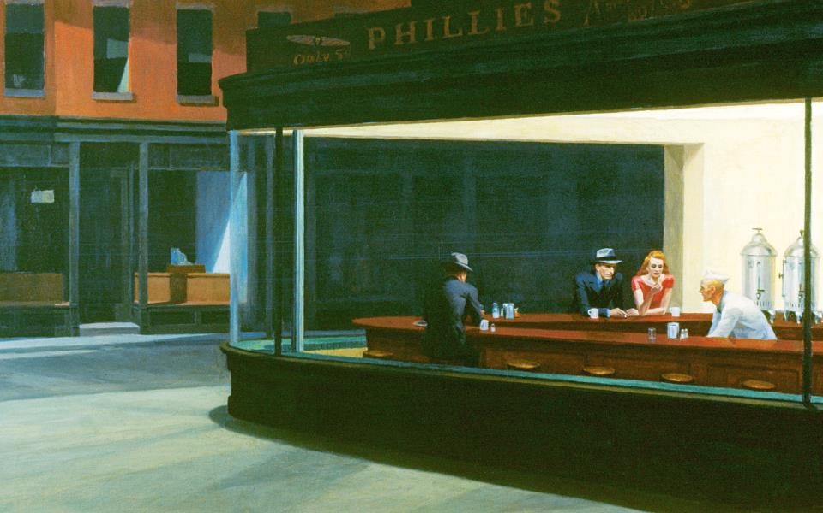

Slide 3
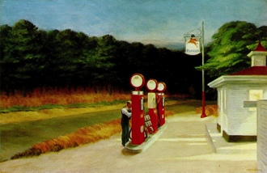

Slide 4
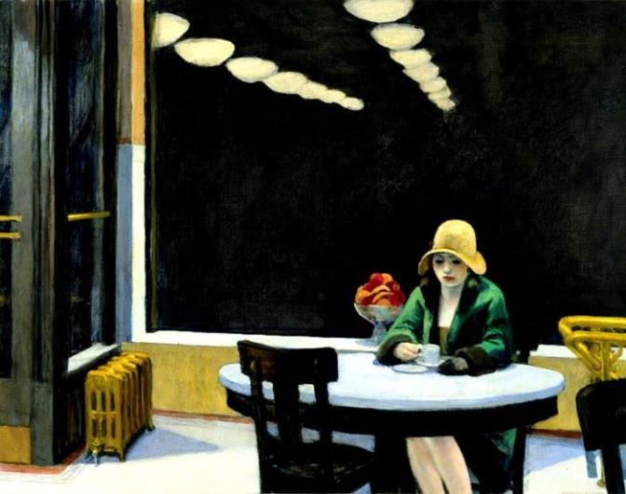

Slide 5
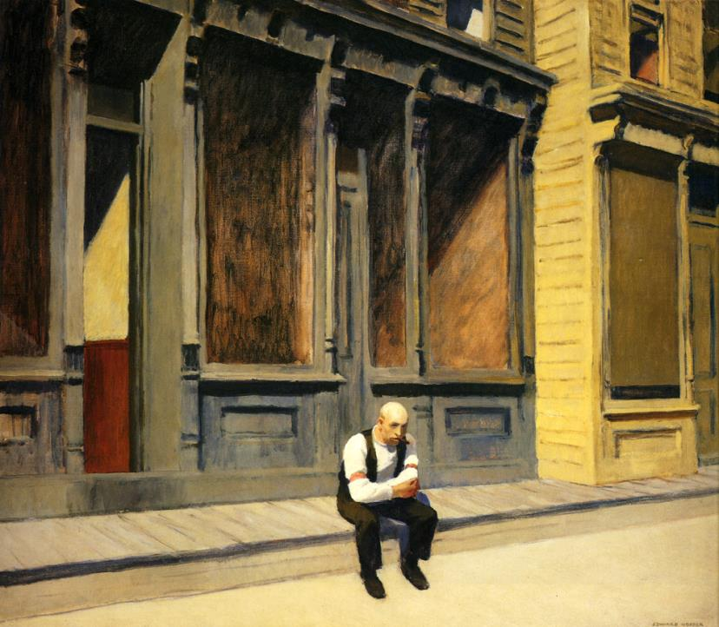

Slide 6
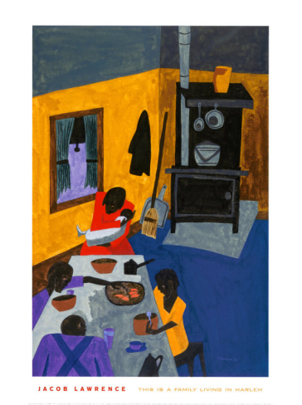

Slide 8
You Decide
Which of the paintings best represented what you felt life was like in the 1940s and 1950s?
Which did you feel best connected with the feelings and sentiments expressed in Death of a Salesman?
What contrasts did you notice between the work of Norman Rockwell and Edward Hopper?
What about Jacob Lawrence and Jackson Pollock?

Slide 9
Death of a Salesman Project
Let the following images/set designs inspire you as we begin our creative response to Miller’s play.
Think about how each reflects the themes, characters, and sentiments expressed through the dramatic choices Miller made.
Create a playbill poster that emphasizes your understanding of the play. This could include interpretations of scenes, characters, symbols.

Slide 10
Rubric
Exemplary – A:
Artifact illustrates a strong critical and creative stance that reflects a depth of textual analysis.
Deliberately and directly analyzes/critiques important textual/literary elements to convey excellent knowledge and understanding of the content and the implications of the work(s) presented.
Very Good or Above Average - B:
Artifact illustrates a fundamentally sound critical textual understanding.
Deliberately and directly analyzes/critiques important textual/literary elements.
Adequate or Average-C:
Artifact merely presents an appropriate and some critical understanding of the text.
Directly Analyzes/critiques some important textual/literary elements. Analysis may be general but substantiated.
Superficial to Little Knowledge: demonstrated – D or U
Artifact presents a generic understanding of the text with little or no analytical insight or support.
Analyzes/critiques few, if any, important direct textual/literary elements. Interpretation and unsubstantiated assumption is passed off as “analysis.”

Slide 11
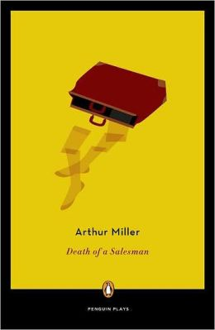

Slide 14
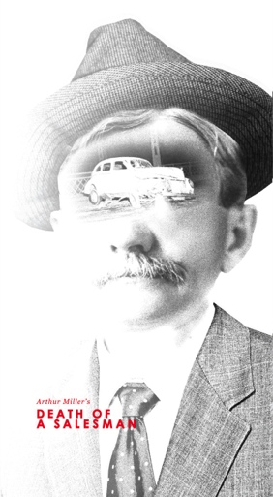

Slide 15
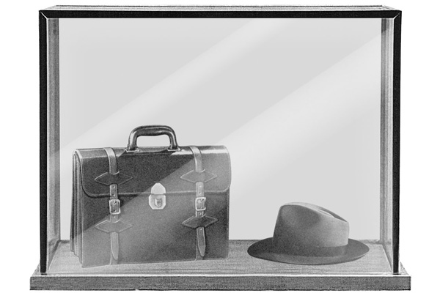

Slide 16
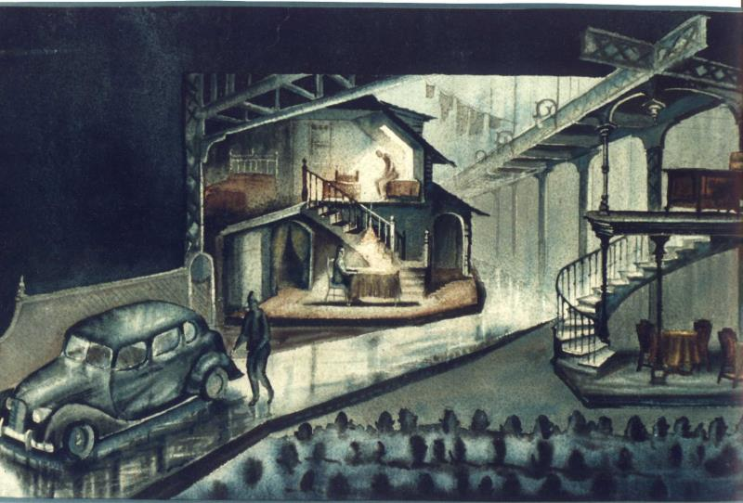

Slide 17
